Slide 1
DEVOPS JOURNEY
Rafique Syed

Slide 2
SDLC Process
Requirement
Design
Development
Testing
Deployment
Maintenance

Slide 3
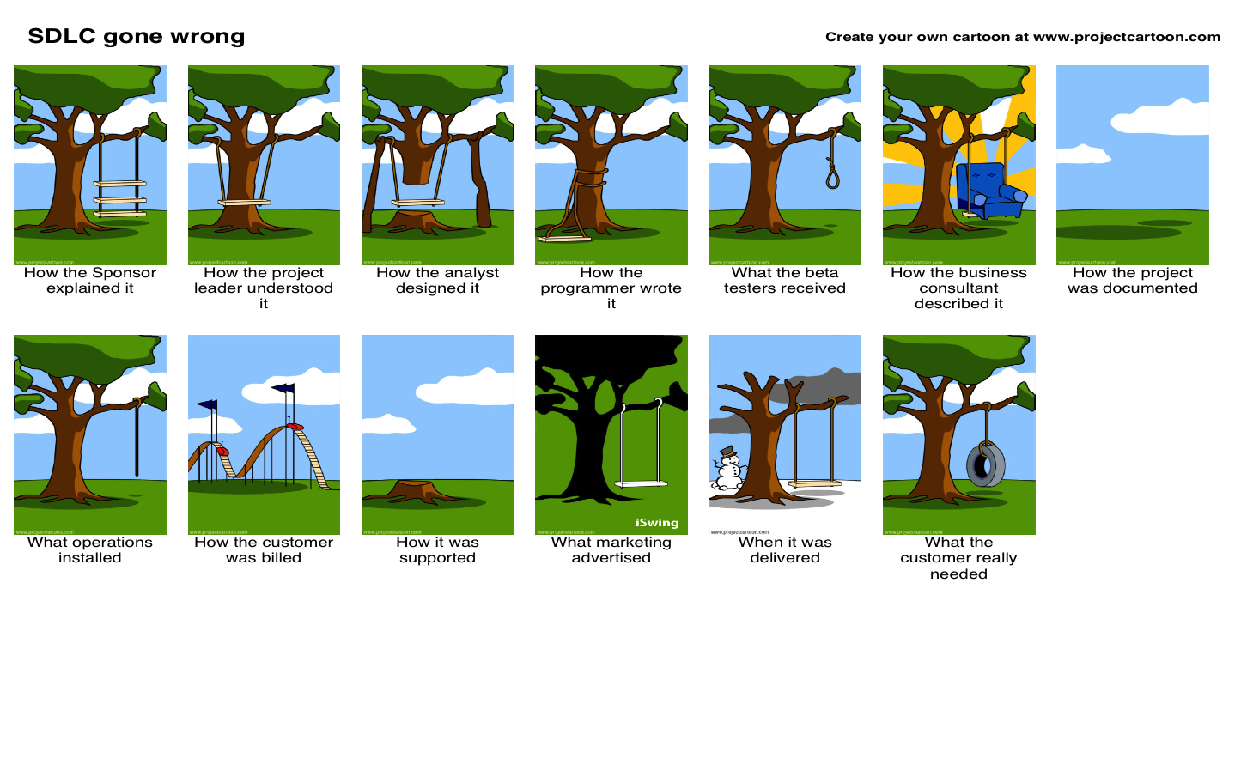
SDLC Gone wrong

Slide 4
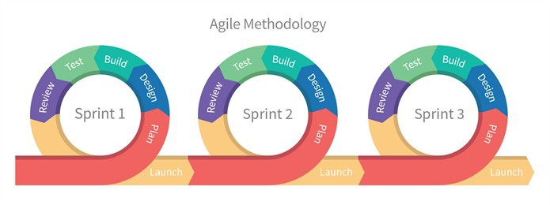
Agile

Slide 5
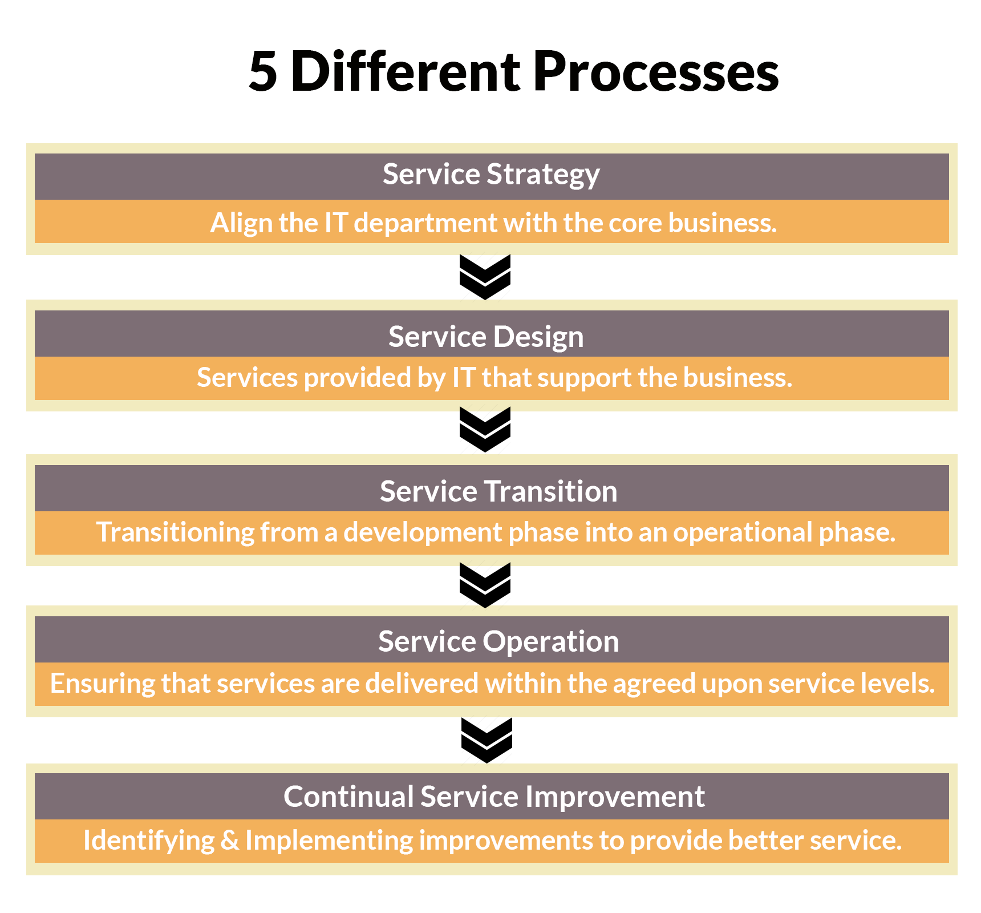
ITIL

Slide 6
End of that era……

Slide 7
Meaning of “#” to Dev & Ops

Slide 8
Unlearn to Learn
DevOps is not spelled as J E N K I N S
DevOps is not Cloud
You can’t buy DevOps
DevOps is not combining Dev + Ops
DevOps is not one-size fits all strategy
DevOps is not automation
DevOps is not something you DO.
“ There are more sales people than Technical people to implement DevOps”

Slide 9
What is DevOps
DevOps is “Respectful Collaboration” which involves “People Process & Technology”
- Marc Hornbeek
Notes:
Toyota production line

Slide 10
Why DevOps
Innovate faster
More responsive to business needs
Better Quality
Shorter development cycles
More frequent release

Slide 11
Why DevOps is Important
Agility { 46 frequent deployments x 440 shorter lead times }
Efficiency { 21 % less time on unplanned work and rework }
Satisfaction { 2.2 x employees more likely to recommend organization as great place to work }
Stability { 96x faster recovery time for failures }
Security { 50% less time remediating security issues }
Quality { 5 x lower change failure rate }
Notes:
DevOps having lot of definitions but there is only one litral meaning. Dev ” + “ OPS

Slide 12
DevOps Journey
DevOps grew out of Lean | Agile | Theory of constrains | Toyota production system | resilience engineering | Learning organisations | safety culture | Human factors….etc.,
2007 : Agile software development was gaining popularity, but it was also suffering from growing divide between development & operations.
2007 : Patrick Debois, an engineer with experience doing both dev and ops, was doing testing on a project and became frustrated by the huge divide between dev & ops
2008 : Patrick Debois and Andrew Shafer met at agile 2008 conference in Toronto, Canda. They began to start conversation and seek others interested in bridging the divide between dev and ops.
Jun 23, 2009 : John Allspaw & Paul Hammond gave a talk in Velocity conference : “10+ deploys per day: Dev & Ops cooperation at Flickr”. Patrick was watching via livestream. People began discussing it via twitter.
October 30-31 2009: Patrick hosted the first DevOpsDays in Ghent, Belgium, a conference for both devs & ops engineers. Conversation continued on twitter #devops
DevOps grew into an organic, grassroots movement all over the world and spawned many tools to support the practices valued by DevOps.
Notes:
DevOps is not spelled as “JENKINS”
DevOps

Slide 13
How DevOps
Easy to get lost in Analysis paralysis
Best way to achieve is to thing simple. Instead of worrying about what practice or tool you need to adopt.

Slide 14
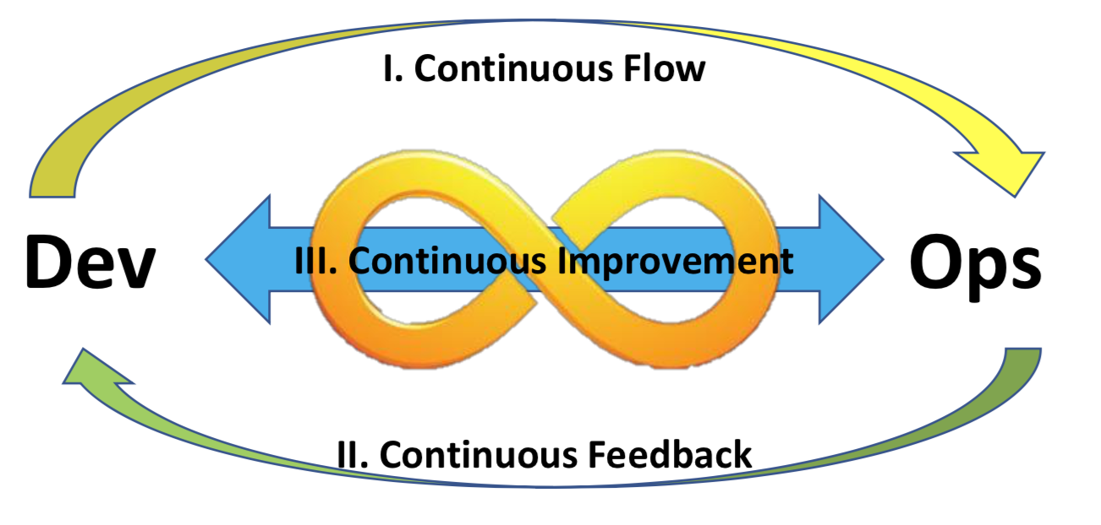
The Three ways
Continuous flow of code changes without human interaction
Continuous improvement
Continuous feedback.
Notes:
Marc Hornbeek

Slide 15
Nine Disciplines
Collaborative Leadership
Collaborative Culture
Design for DevOps
Continuous Integration
Continuous Testing
Elastic Infrastructures
Continuous Monitoring
Continuous Security
Continuous Delivery/Deployment
Notes:
Marc Hornbeek

Slide 16
Leadership (People & Culture)
Leaders inspire pride, passion and motivation and encourages people to see that change brings opportunities
Communication flows fluidly across the end-to- end cross-functional team using collaboration tools where appropriate

Slide 17
Value Streams (process)
Value stream mapping is a lean manufacturing visualization tool for recording all the processes that are required to bring a product to market... to identify processes that do not provide value so they can be improved
Automate workflows by standardizing development, test and production environments, deploy and manage cloud resources, eliminate error-prone, time-consuming manual tasks, improve cooperation between development and operations and implement automated release pipelines.

Slide 18
Application (Technology)
Applications: 12-factor apps, Elastic / cloud, Service oriented, Microservices, Containers, Testability, Observability
Toolchain: Self service , APIs, Elastic, scalable , Orchestration, Automation, Containers, Observability

Slide 19
Culture
Even with the best tools, DevOps is just another buzzword if you don't have the right culture. — Martin Fowler
Effective DevOps requires Development, QA and Operations teams to harmonize their cultures into a common collaborative culture focussed on common goals.

Slide 20
Engineering Continuous Delivery Architectures
Commit stage
Compile|Unit test| Analysis | Build deploy
Automated acceptance testing
Automated Capacity Testing
Manual Testing
Release
Delivery Pipeline
Notes:
Jezz Humble

Slide 21
DevOps maturity Model
5
Optimising DevOps
DevOps Done – Fine tuning and tied tightly to business goals and its continuous process
4
Managed DevOps
Happy people with integrated toolchain to pre-empt failure, automate test and deployment – Continuous Delivery
3
Defined DevOps
Automated build, cross functional teams, product-focused, cultural change happening
2
Starting DevOps
Thinking about cultural change, starting to write scripts, ,looking at test automation
1
Not Started DevOps
Silos | No Product Ownership | Outages | War Rooms | Blame | unplanned work | delays and defects

Slide 22
DEVOPS AT SCALE
Teams that excel do so not just because they have the best members, best tools, best coaches, Best process or best leaders and coaches.
They Excel because they, as a team, have all of the above but also know what to do when they face various situations and challenges.

Slide 23
Continuum
Respectful collaboration
empowered engineer’s than instruction driven Engineers
Close collaboration with other teams - Don’t limit to desk.
There are no stupid questions

Slide 24
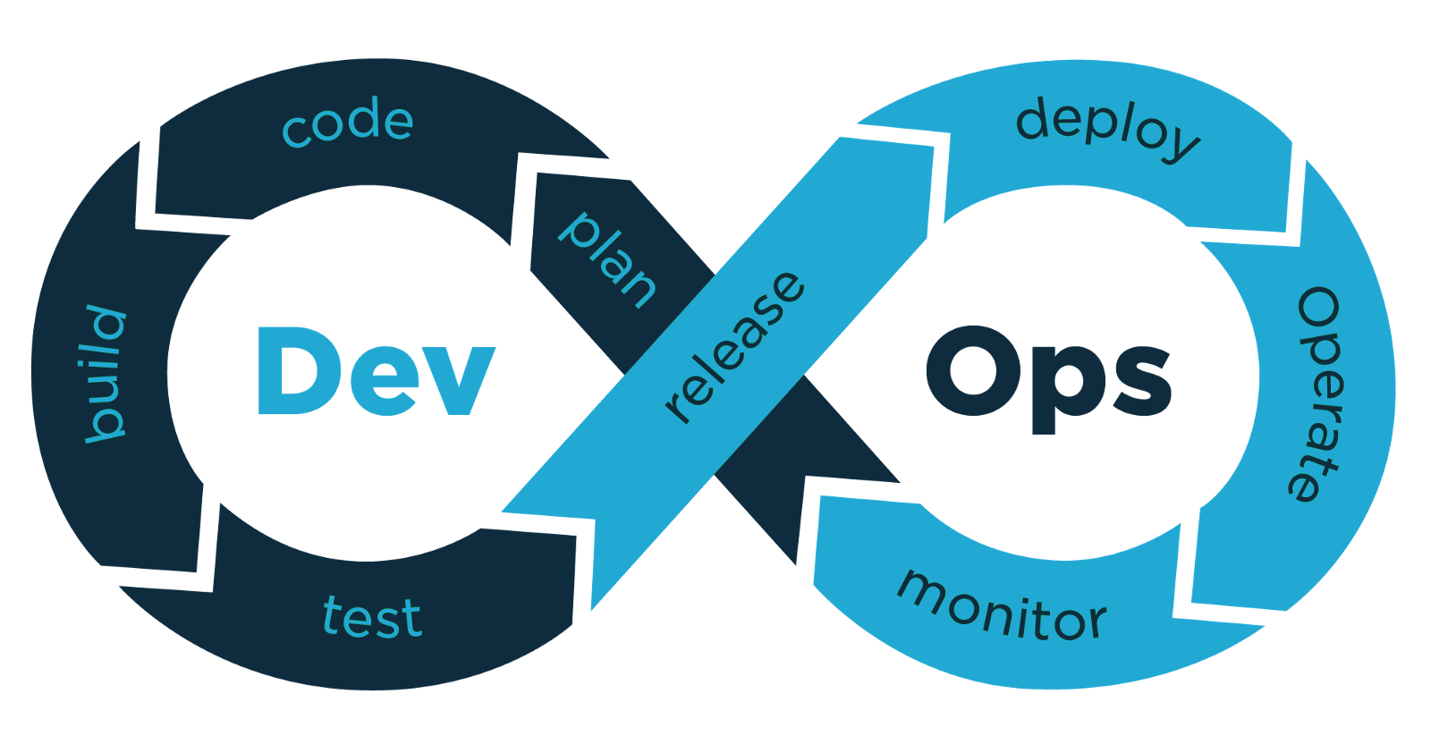
Thanks you
Continuous Learning

